Slide 1
School of Geography and Geology
McMaster University
Advanced Topics in Spatial Statistics
Point Pattern Analysis IV

Slide 2
Last session:
Part III: Point Pattern Analysis
  Definitions
  First and Second Order Properties
  Visualizing Point Patterns
  Exploring Point Patterns
    Quadrat counts
    Kernel Estimation

Slide 3
This session:
Part III: Point Pattern Analysis
  Exploring point patterns
    Quadrat Analysis and Moving Windows
    Kernel Estimation
      Edge Effects
      Window Size
    Second Order Properties
    Nearest Neighbor Distances
    The K Function

Slide 4
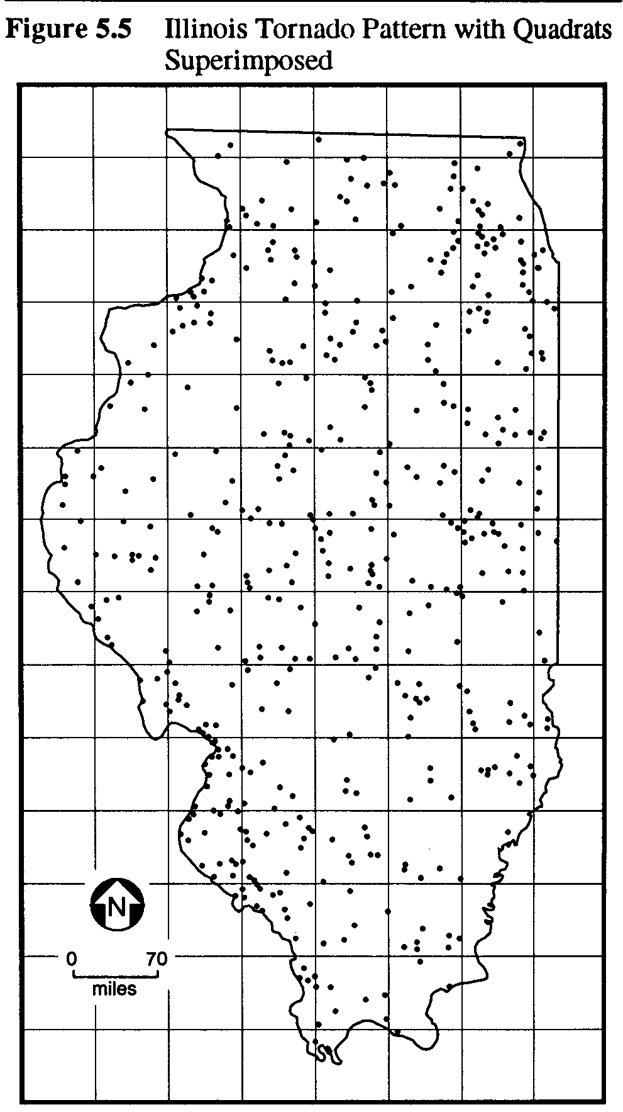
First order properties
Intensity –
Mean number of events per unit area at point s

Slide 5
First order properties
Quadrat analysis
(Moving windows)
Kernel estimation

Slide 6
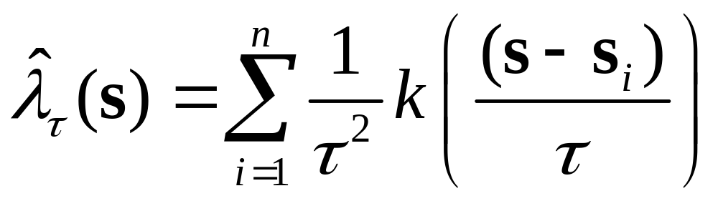
Kernel estimation
Smooth estimate of intensity

Slide 7
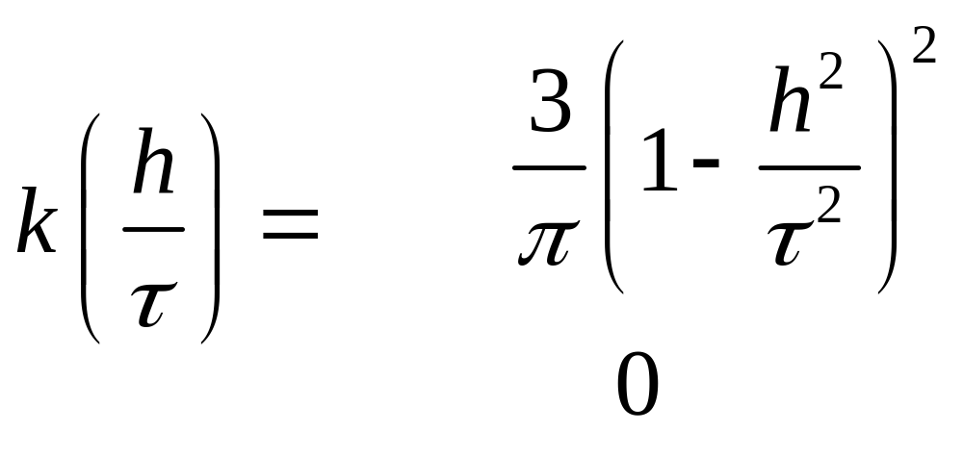
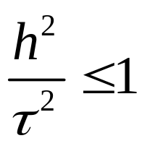
Kernel estimation
Kernel function
if
otherwise

Slide 8
Kernel estimation
Kernel function
s
s_{i}
h_{i}
τ

Slide 9
Kernel estimation

Slide 10
Kernel estimation
Edge effects?

Slide 11
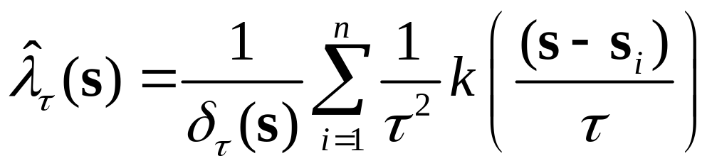
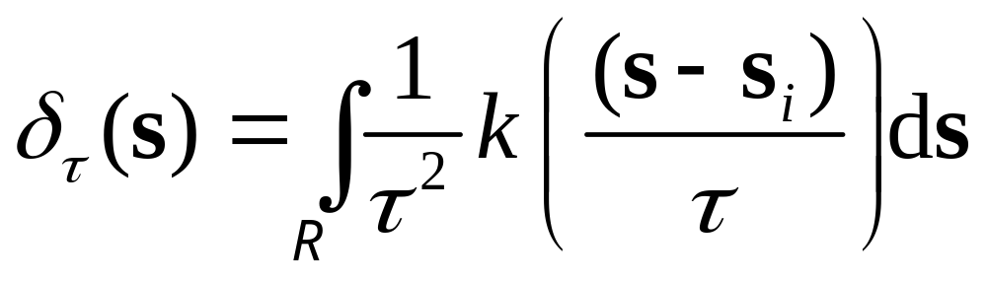
Kernel estimation
Edge correction
Volume of kernel that is within R

Slide 12
Kernel estimation
Window size?
  Visualization and exploration
  Distribution of events

Slide 13
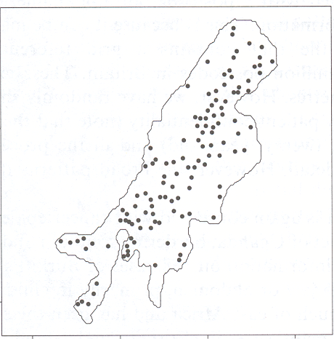
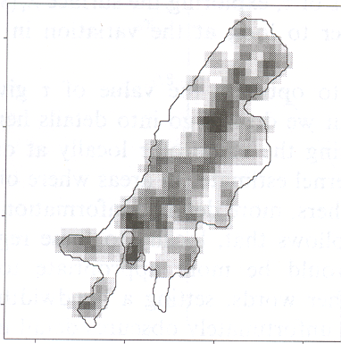
Kernel estimation
Example: Volcanic craters in Uganda (τ=100)

Slide 14
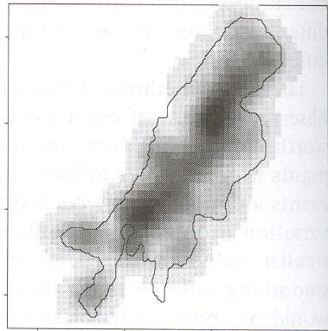
Kernel estimation
Example: Volcanic craters in Uganda (τ=220)

Slide 15
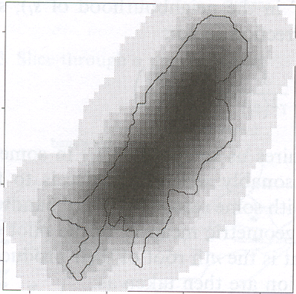
Kernel estimation
Example: Volcanic craters in Uganda (τ=500)

Slide 16
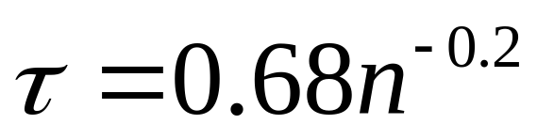
Kernel estimation
Window size (Visualization and exploration)
  Rule of thumb (for R square unit)
  (This must be scaled appropriately)

Slide 17
Kernel estimation
Window size

Slide 18
Kernel estimation
Adaptive kernel bandwidths

Slide 19
Second order properties
Small scale variation

Slide 20
Second order properties
Small scale variation

Slide 21
Second order properties
Small scale variation

Slide 22
Second order properties
Small scale variation

Slide 23
Second order properties
Nearest neighbor analysis
K functions

Slide 24
Nearest neighbor analysis
Event-Event nearest neighbor analysis
  Applicable only to mapped point patterns
Point-Event nearest neighbor analysis
  Applicable to mapped point patterns or for sampling purposes

Slide 25
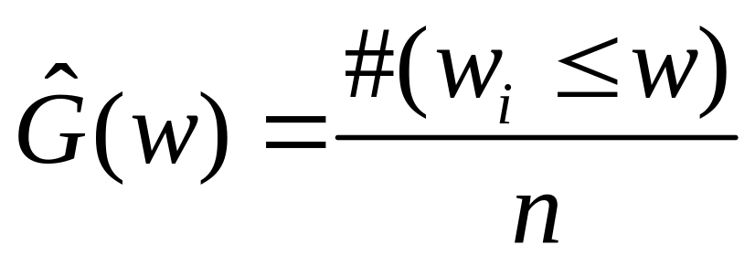
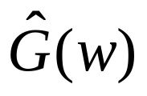
Nearest neighbor analysis
Event-Event nearest neighbor analysis (distribution function)
w_{i} : Distance from event i to nearest neighbor
w : Distance
n : Number of events
Q: What is the range of possible values for ?

Slide 26
Nearest neighbor analysis
Event-Event nearest neighbor analysis

Slide 27
Nearest neighbor analysis
Event-Event nearest neighbor analysis (distribution function)
Q: What is the range of possible values for ?

Slide 28

Nearest neighbor analysis
Distribution function
1
0
Distance w

Slide 29
Nearest neighbor analysis
Clustering?

Slide 30
Nearest neighbor analysis
Clustering?
1
0
Distance w

Slide 31
Definitions: Patterns
Regularity?

Slide 32
Nearest neighbor analysis
Regularity?
1
0
Distance w

Slide 33
Nearest neighbor analysis
Sampled point pattern
Recorded
event
Unrecorded
event

Slide 34
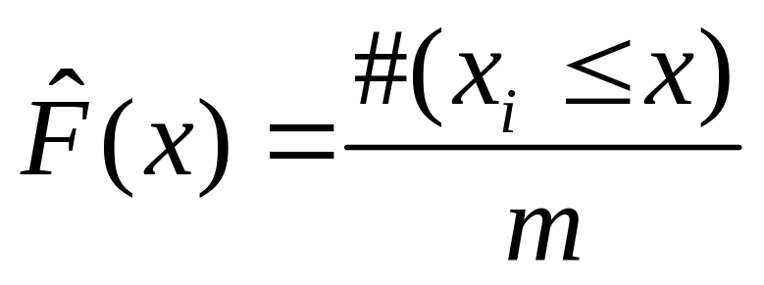
Nearest neighbor analysis
Point-Event nearest neighbor analysis
x_{i} : Distance from point i to nearest event
x : Distance
m : Number of points

Slide 35
Nearest neighbor analysis
Point-Event nearest neighbor analysis
Event
Point

Slide 36
Nearest neighbor analysis
Clustering?

Slide 37
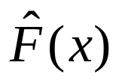
Nearest neighbor analysis
Clustering?
1
0
Distance x

Slide 38
Definitions: Patterns
Regularity?

Slide 39
Nearest neighbor analysis
Regularity?
1
0
Distance x

Slide 40
Nearest neighbor analysis
Check for random patterns
1
0
1

Slide 41
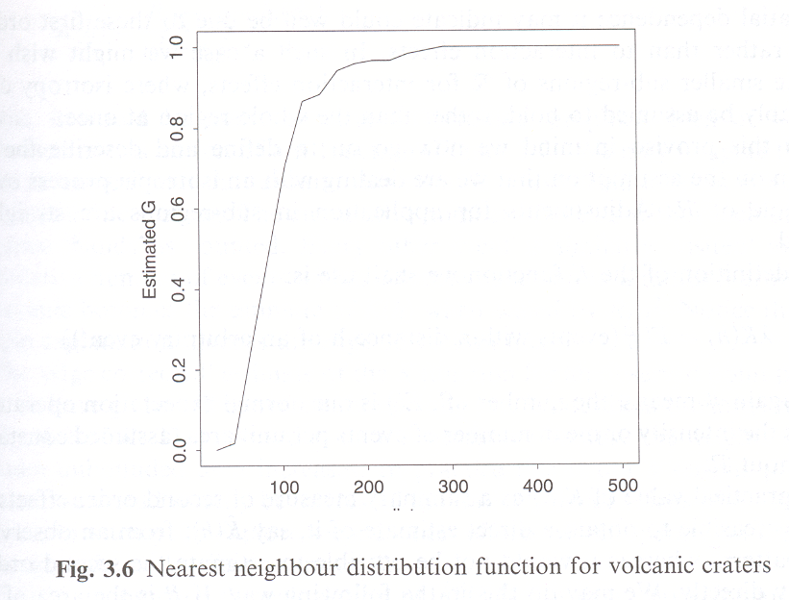
Nearest neighbor analysis
Example

Slide 42
Nearest neighbor analysis
Edge effects

Slide 43
Nearest neighbor analysis
Edge effects: remedial measures
  Guard area

Slide 44
Nearest neighbor analysis
Edge effects: remedial measures
  Toroidal correction

Slide 45
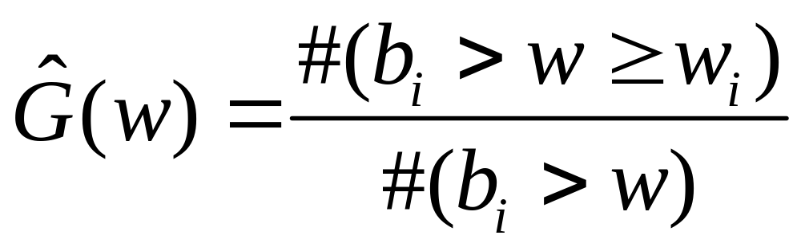
Nearest neighbor analysis
Event-Event nearest neighbor analysis with edge correction

Slide 46
Nearest neighbor analysis
Distance to nearest neighbor only
Small scale analysis – no indication of what happens at other scales

Slide 47
The K function
Various scales
Implicit assumptions
  Homogeneity
  Isotropy

Slide 48
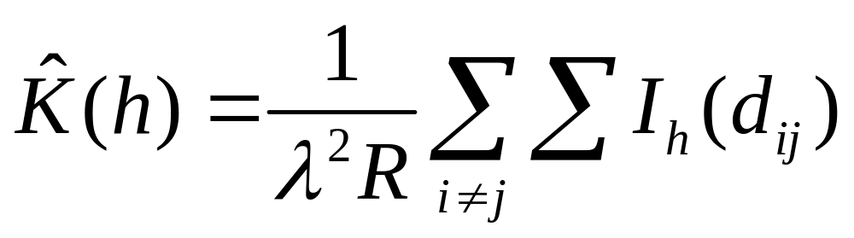
The K function
λK(h)=
E(#(events within distance h of an arbitrary event))
λ : Intensity
R : Area of region R
I_{h} : Indicator function (1 if d_{ij}<h, 0 otherwise)

Slide 49
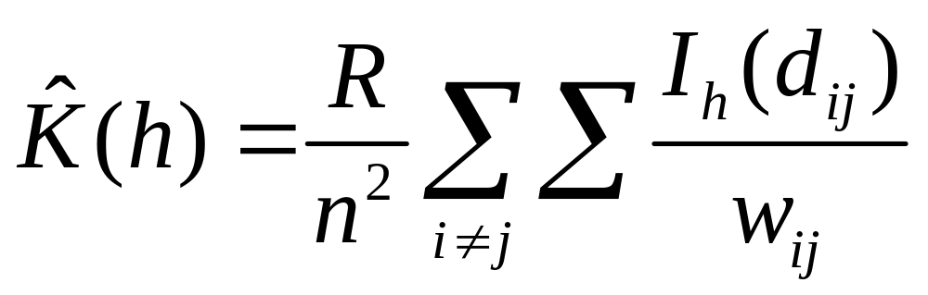
The K function
λ=n/R
w_{ij}= weight to correct for edge effects

Slide 50
The K function
Four events within distance 5 of event i

Slide 51
The K function
Four events within distance 5 of event i

Slide 52
The L function
If the point pattern is random:
K(h)=πh²
Under regularity:
K(h)<πh²
Under clustering:
K(h)>πh²

Slide 53
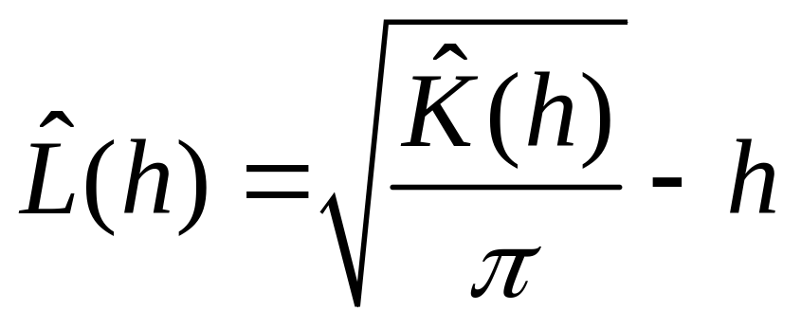
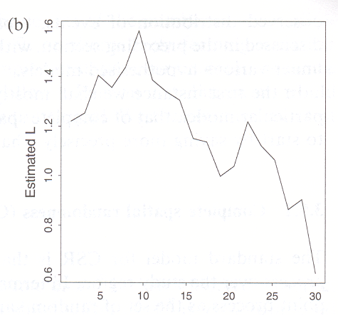
The L function
Compare the K function to the basic random condition

Slide 54
The L function
Example: The L function plotted

Slide 55
Next …
PART IV: Spatially continuous data

